Slide 1

Firebase

Slide 2
How to
1. Login to Firebase console
2. Create a new project
3. Copy the code to your project
4. Use Firebase

Slide 3
Firebase Tools
$ npm install -g firebase-tools
$ firebase login
$ firebase serve

Slide 4
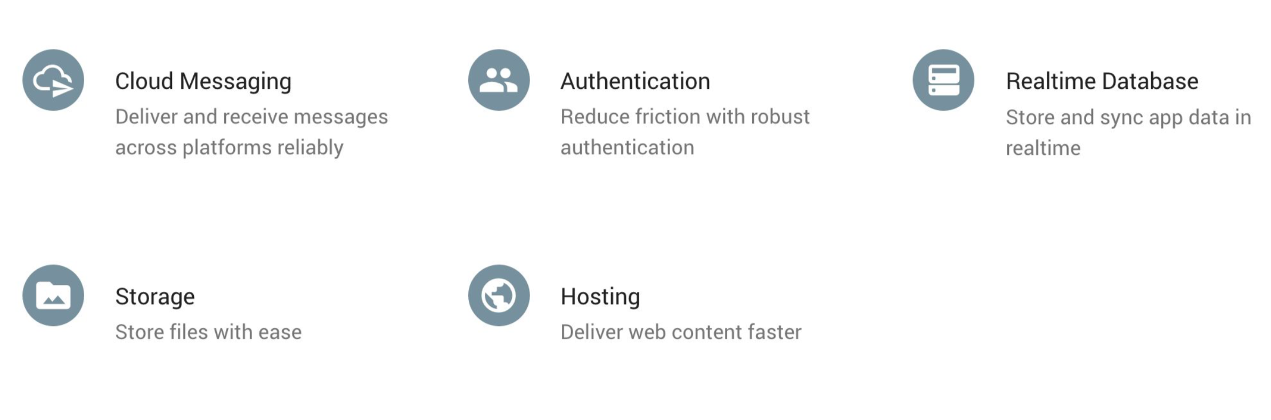
Firebase For the Web
Cloud Messaging
Authentication
Realtime Database
Storage
Hosting

Slide 5

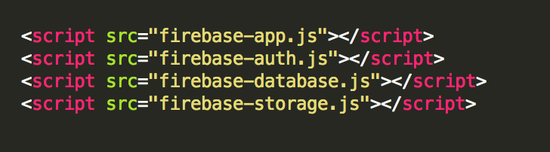
or

Slide 6
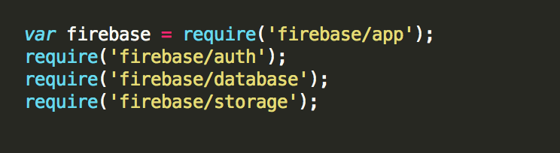

Slide 7
Auth
Email/Password
Providers
Google, Facebook, Twitter, Github
Anonymous
Custom auth system integration
Needs to be enabled in Firebase console

Slide 8
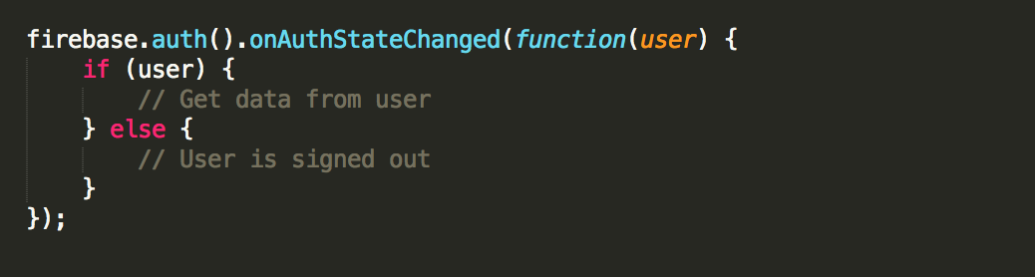
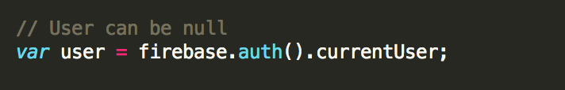
Auth

Slide 9
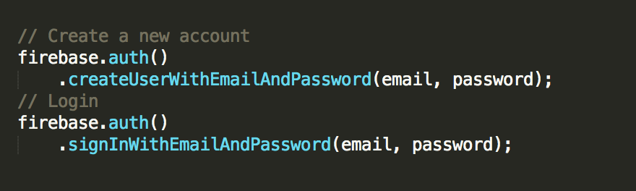
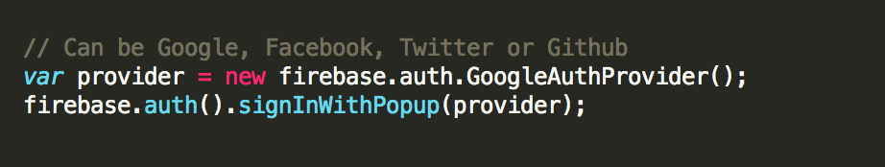
Auth

Slide 10
Database
Cloud hosted storage
Data is stored as JSON
Realtime synchronization
Automatic updates Offline support

Slide 11
Database - Retrieve
Asynchronous listening to events :
value
child_added
child_changed
child_removed
child_moved

Slide 12
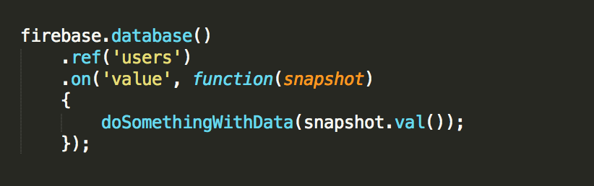
Database - Retrieve
Asynchronous listening to events :
value
child_added
child_changed
child_removed
child_moved

Slide 13
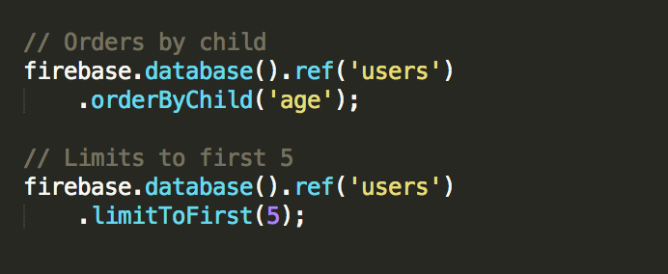
Database - Sort, Filter

Slide 14
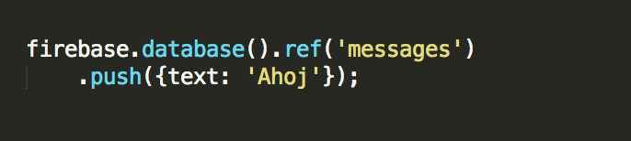
Database - Save
Methods :
set()
push()
update()
transaction()

Slide 15
Rules
Read and write access to db/storage
How data are structured
What indexes exist
From Firebase console

Slide 16
Storage
Backed by Google Cloud Storage
Files stored in Firebase storage buck

Slide 17
Cloud Messaging
For Chrome and Chrome apps/extensions

Slide 18
Hosting
Static hosting for web apps firebaseapp.com subdomain Firebase CLI needed
$ firebase init $ firebase deploy

Slide 19


